Slide 1


Dept of AIML

Slide 2
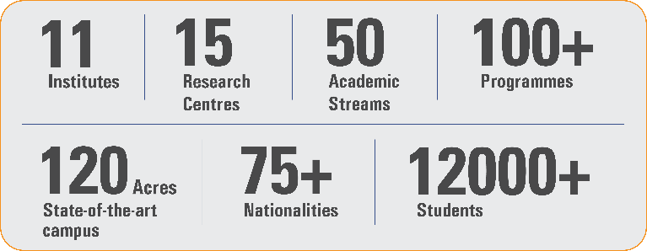
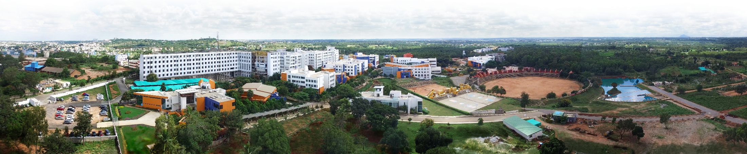
Overveiw
Acharya stands as a beacon of excellence in higher education, boasting a legacy of academic distinction since its establishment in 1990. We offer a transformative educational experience, fostering holistic development, nurturing innovation and providing world-class facilities to ensure an enriching journey for our students.
Dept of AIML

Slide 3
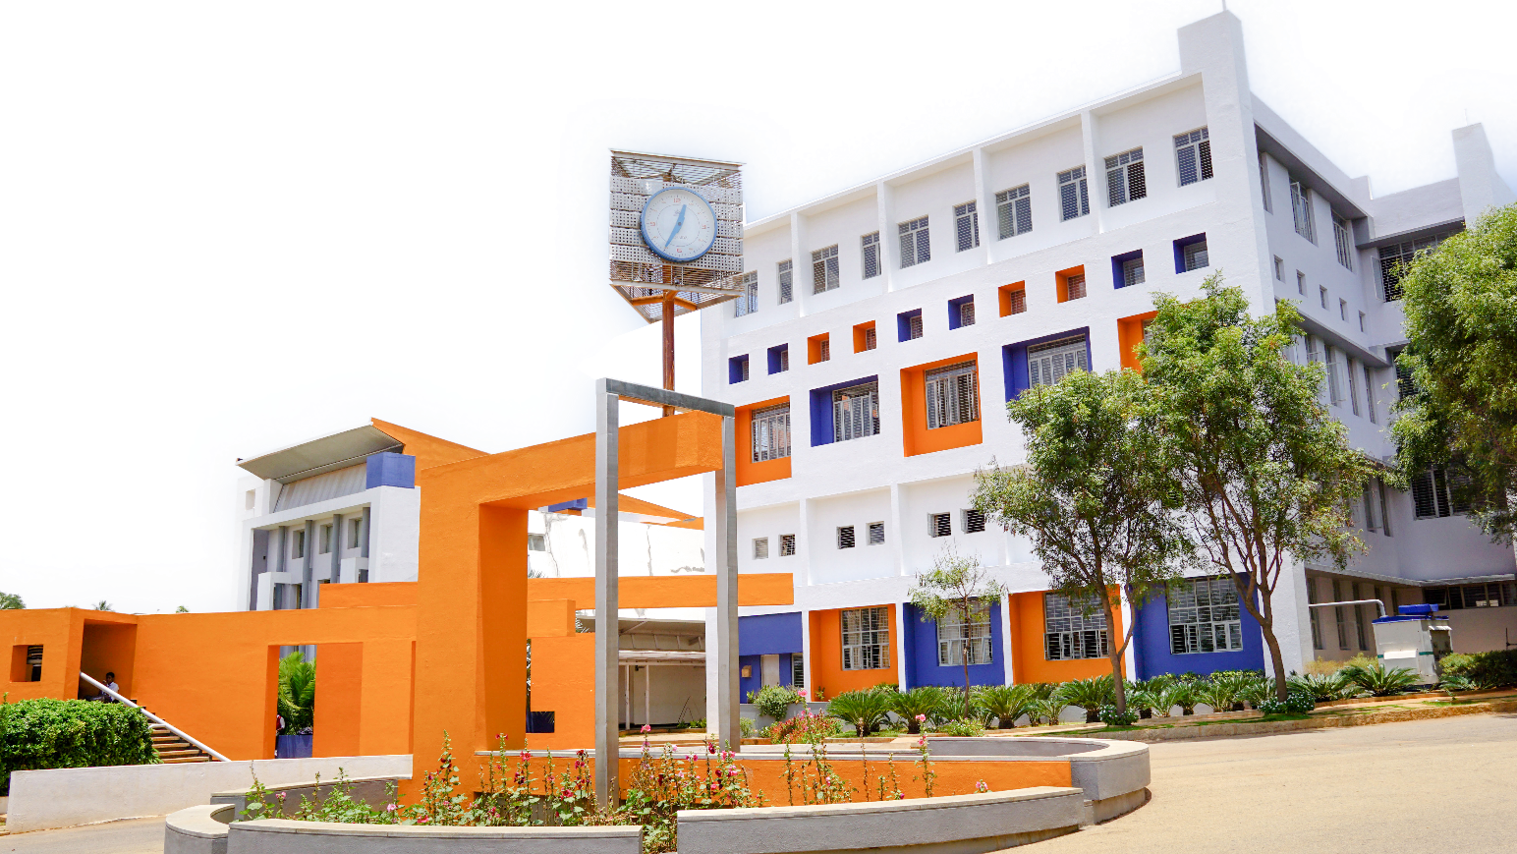
11 Institutions, Infinite Possibilities
We provide 100+ programs across 50 academic streams.
Dept of AIML

Slide 4
DATA:TRAIN
TopicName: Superconductivity data preprocessing and analysis
PresentedBy: Suraksha
USN: 1AY23AI126
Dept of AIML

Slide 5
TABLE OF CONTENTS:
1.Overview of dataset
2.Data preprocessing
3.Data analysis-8 questions
Dept of AIML

Slide 6
Dataset Overview:
Source: this data was extracted from the census bureau database
Found at : https://archive.ics.uci.edu/dataset/464/superconductivty+data
This dataset is a Superconductivity Data, appears to be a collection of data points related to superconductivity. Superconductivity is a phenomenon where certain materials exhibit zero electrical resistance and expel magnetic fields below a critical temperature.
Features: The data likely contains various features that might influence superconductivity in a material. These features could include:
* Elemental composition of the material
* Crystal structure information
* Processing parameters
* Transition temperature (critical temperature at which the material becomes superconducting)
* Other relevant physical or chemical properties
* Data format: The data might be stored in a format like CSV (comma-separated values), TSV (tab-separated values), or ARFF (Attribute-Relation File Format).
* Data size: The number of data points and the number of features will determine the size of the dataset.
Dept of AIML

Slide 7
Data preprocessing
*Loading and analysing the dataset
#to load a csv file into R
p=read.csv(file.choose())
# to open the data frame o in a spreadsheet-like viewer
view(p)
#to display the structure of an object
str(p)
#to get the summary of the dataset
summary(p)
*Data cleaning
#to check weather there are any NA values in the dataset
i=is.na(p)
i
# Remove rows with missing values
o <- na.omit(p)
o
# Replace missing values with a specific value (e.g., mean of a column)
data$column_name[is.na(data$column_name)] <- mean(data$column_name, na.rm = TRUE)
Dept of AIML

Slide 8
Data analysis-8 questions
1. What is the correlation between entropy atomic mass and range atomic mass of an element?
correlation=cor(o$entropy_atomic_mass,o$range_atomic_mass,use="complete.obs")
correlation
Output:
> correlation=cor(o$entropy_atomic_mass,o$range_atomic_mass,use="complete.obs")
> correlation
[1] 0.5387739
Here,
The correlation coefficient ranges between -1 and 1:+1: Perfect positive correlation (both variables increase together).0: No correlation.-1: Perfect negative correlation (one variable increases as the other decreases).A value of 0.5388 indicates a moderate positive correlation between entropy_atomic_mass and range_atomic_mass. This means that as one of these variables increases, the other tends to increase as well, but not perfectly.
Dept of AIML

Slide 9
2.find pearson and spearman correllation coefficients,and find they similar or not
pear=cor(o$entropy_atomic_mass,o$range_atomic_mass,method = "pearson")
spear=cor(o$entropy_atomic_mass,o$range_atomic_mass,method="spearman")
Pear
Spear
if(abs(pear-spear<.1)){
cat("they are similar")
}else{ cat("they are not similar")}
Output:
> pear
[1] 0.5387739
> spear
[1] 0.5114234
> if(abs(pear-spear<.1)){
+ cat("they are similar")
+ }else{
+ cat("they are not similar")
+ }
they are similar
The code calculates **Pearson** (linear relationship) and **Spearman** (rank-based) correlation coefficients for `entropy_atomic_mass` and `range_atomic_mass`. Since the absolute difference between the two values (**0.5388** and **0.5114**) is less than 0.1, the code concludes that they are similar.
Dept of AIML

Slide 10
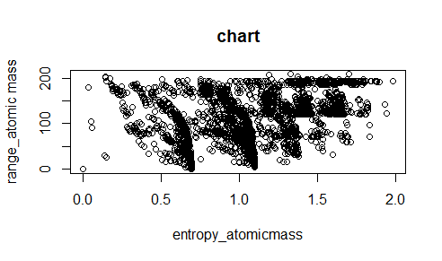
3.plot the graph of the of any two columns first without log function and then with log function and spot the difference
plot(o$entropy_atomic_mass,o$range_atomic_mass,main="chart",xlab="entropy_atomicmass",ylab="range_atomicmass")
plot(log(o$entropy_atomic_mass),log(o$range_atomic_mass),main="chart",xlab="entropy_atomicmass",ylab="range_atomic mass")
Output:
Without log function
Dept of AIML

Slide 11
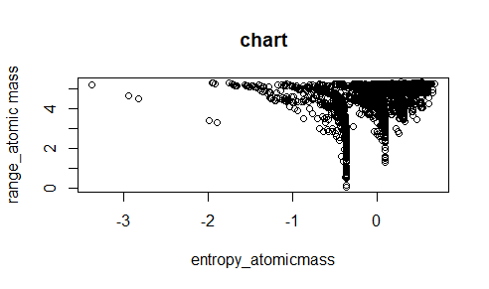
With log function
The code generates two scatter plots to compare the relationship between `entropy_atomic_mass` and `range_atomic_mass`.
1. First plot: It directly plots the raw values of the two columns.
2. Second plot: It applies the logarithmic transformation (`log()`) to both columns before plotting.
The log transformation often helps visualize data with large ranges or skewed distributions by compressing larger values and spreading out smaller ones, making patterns or relationships easier to observe.
Dept of AIML

Slide 12
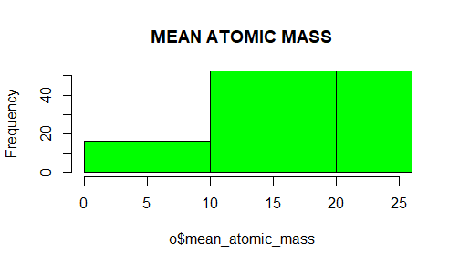
4.create a histogram on any column using hist function ,add colours and provide axis limits
hist(o$mean_atomic_mass,main="MEANATOMICMASS",col="green",border="black",xlim=c(0,25),ylim=c(0,50))
Output:
This code creates a histogram of the `mean_atomic_mass` column, adding a green color to the bars and black borders. The x-axis is limited to the range 0–25 (`xlim`), and the y-axis to 0–50 (`ylim`). The title of the histogram is "MEANATOMICMASS."
Dept of AIML

Slide 13
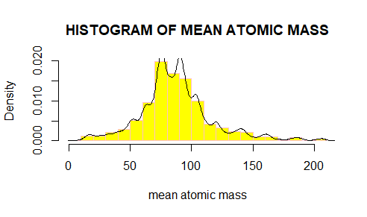
5.Add a density curve for the histogram created in the previous question
hist(o$mean_atomic_mass,main="HISTOGRAM OF MEAN ATOMIC MASS",xlab="mean atomicmass",ylab="Density",col="yellow",border="pink",freq=FALSE)lines(density(na.omit(mean_atomic_mass),col="black",lwd=2))
Output:
This code creates a histogram of the `mean_atomic_mass` column with yellow bars and pink borders, displaying density instead of frequency (`freq=FALSE`). It overlays a black density curve (`lines(density(...))`) to show the distribution of the data.
Dept of AIML

Slide 14
6.what is the maximum value of entropy atomic mass and what is the minimum value of entropy atomic mass
max_value=max(o$entropy_atomic_mass)
max_value
min_value=min(o$entropy_atomic_mass)
min_value
Output:
> max_value=max(o$entropy_atomic_mass)
> max_value
[1] 1.983797
>
> min_value=min(o$entropy_atomic_mass)
> min_value
[1] 0
This code calculates the maximum and minimum values of the `entropy_atomic_mass` column using the `max()` and `min()` functions. The results show the highest value as 1.983797 and the lowest value as 0.
Dept of AIML

Slide 15
7.Find the number of rows and columns present in your dataset and also find the average of number of elements in the dataset?
cat("number of rows",nrow(o))
cat("number of columns",ncol(o))
average_no_elements=mean(o$number_of_elements)
average_no_elements
Output:
> cat("number of rows",nrow(o))
number of rows 21263> cat("number of columns",ncol(o))
number of columns 82> average_no_elements=mean(o$number_of_elements)
> average_no_elements
[1] 4.115224
This code determines the number of rows (`nrow()`) and columns (`ncol()`) in the dataset, printing "21263" rows and "82" columns. It also calculates the average of the `number_of_elements` column using the `mean()` function, yielding a result of 4.115224.
Dept of AIML

Slide 16
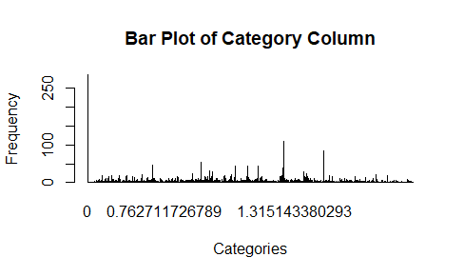
8. using barplot and boxplot functions plot any one coloumn of your dataset
#Barplot
barplot(table(o$wtd_entropy_atomic_mass),
main = "Bar Plot of Category Column",
xlab = "Categories",
ylab = "Frequency",
col = rainbow(length(unique(o$wtd_entropy_atomic_mass))))
Output
Dept of AIML

Slide 17
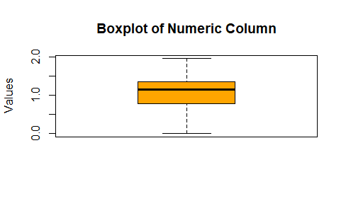
#boxplot
boxplot(o$wtd_entropy_atomic_mass,
main = "Boxplot of Numeric Column",
ylab = "Values",
col = "orange")
Output:
This code generates a bar plot showing the frequency of each unique value in the wtd_entropy_atomic_mass column and a box plot visualizing the distribution (median, quartiles, outliers) of the same column. Both plots provide different perspectives on the data within the wtd_entropy_atomic_mass column.
Dept of AIML

Slide 18
THANK YOU
Dept of AIML

